Slide 1
Scalable Algorithmic Techniques (Ch. 4-5 Lin Snyder Text)
Johnnie W. Baker
Feb 23 2011

Slide 2
Overview & Acknowledgements
We have already quickly covered the slides from Larry Snyder on the Peril-L language from Chapter 4.
The primary references for this set of slides are
Larry Snyder’s slides for Chapters 4 and 5
Chapters 4-5 of the Lin-Snyder textbook.

Slide 3
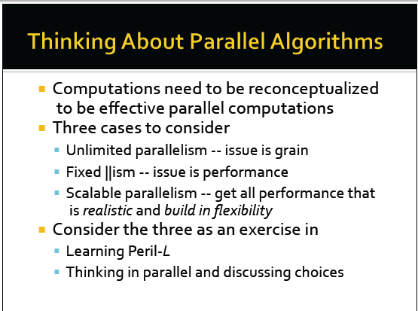

Slide 4
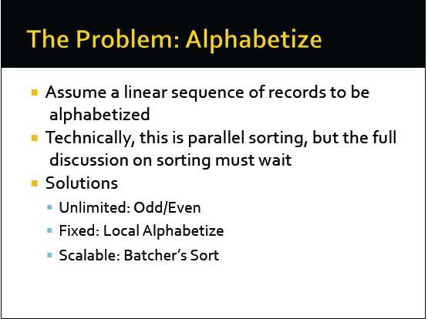

Slide 5
Unlimited Parallelism (Odd-Even Sort)
The Odd-Even Interchange Sort can utilize up to ½ the number of records being sorted.
This allows one-half of the records to be simultaneously compared to the other half of the records.
In a sequence of steps, consecutive odd/even pairs of values are compared in parallel, and are interchanged if they are out of order.
This half-step odd/even comparison is followed by a similar even/odd pair comparisons.
This alternating pairs of test –odd /even pairs followed by even/odd pairs – are executed in sequence until no more interchanges occur.
Although there is plenty of concurrency, there is also plenty of copying.
A list with the smallest element at the end will move it through every position in the file.

Slide 6
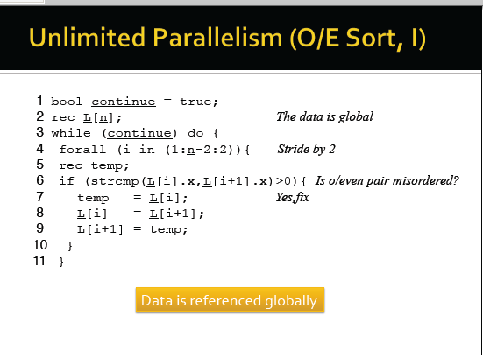

Slide 7
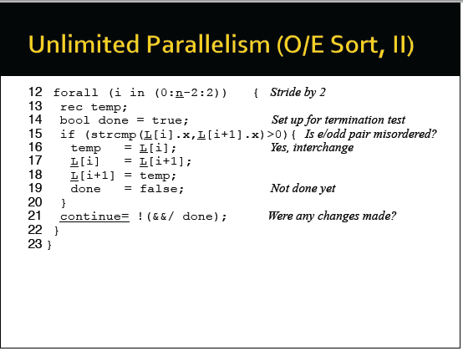

Slide 8
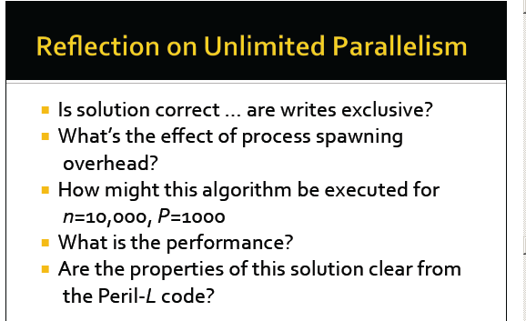

Slide 9
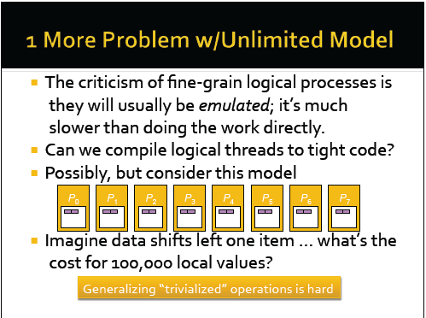

Slide 10
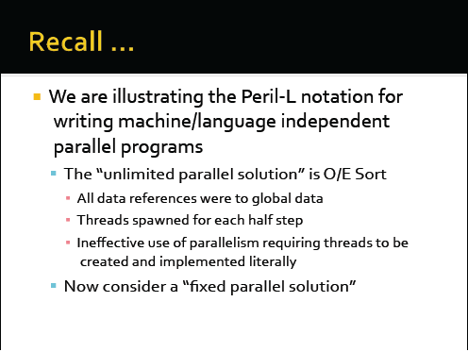

Slide 11
Fixed Algorithm
Create a thread for each letter of the alphabet – 26 Latin letters.
Each thread counts the number of records that start with its letter
Allocate storage for those records and move them into local storage for their thread.
Sort records within each thread.
Each determines the number of records preceding its records.
Using a +-scan, each threads computes the global position for each of its records and writes its records back into the global array at the proper location.
OK to overwrite earlier records since they all are now stored in local storage.

Slide 12
Fixed Algorithm Comments
Note the alphabetized batches cannot be returned to the global array until all threads have removed their batch of records from it.
This algorithm solution is better than the unlimited parallelism version, but the number of parallel threads is fixed at 26 and does not scale.

Slide 13
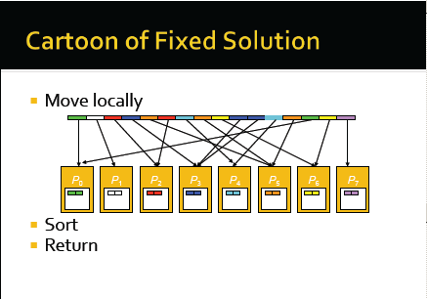

Slide 14
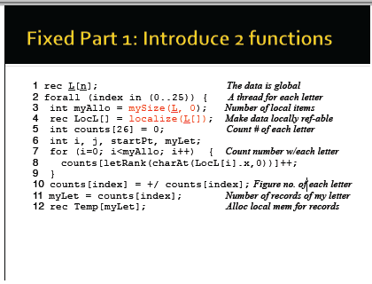

Slide 15
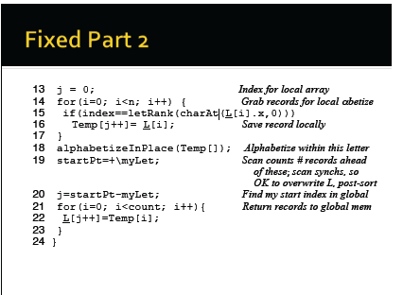

Slide 16
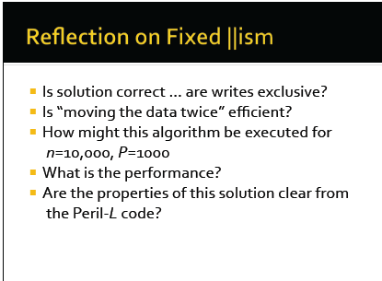

Slide 17
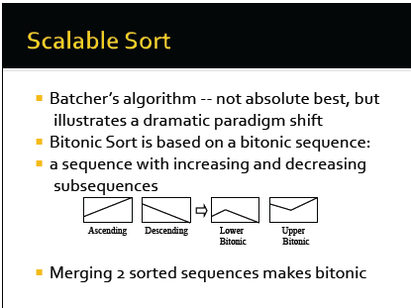

Slide 18
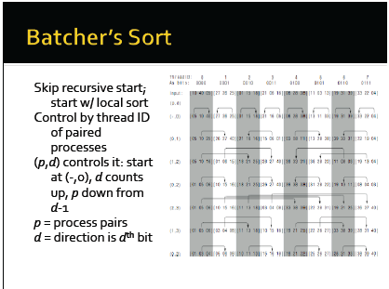

Slide 19
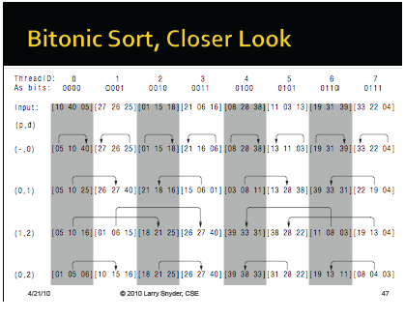

Slide 20
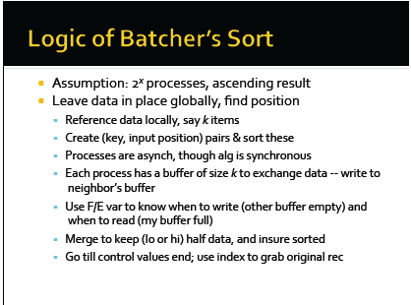

Slide 21
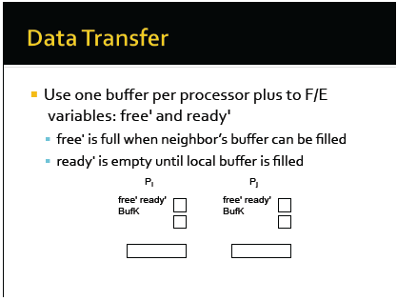

Slide 22
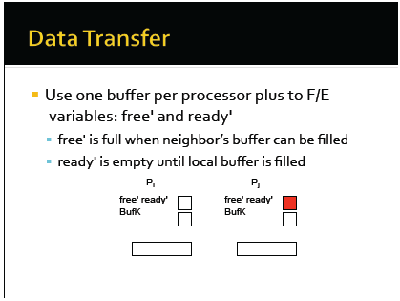

Slide 23
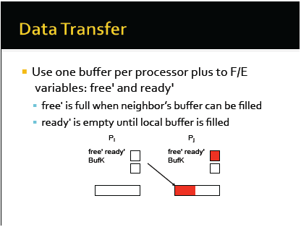

Slide 24
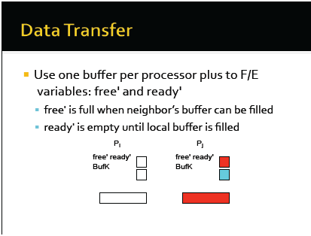

Slide 25
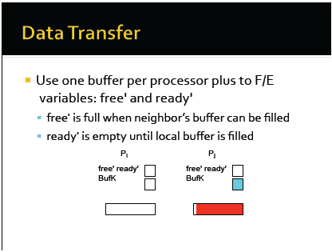

Slide 26
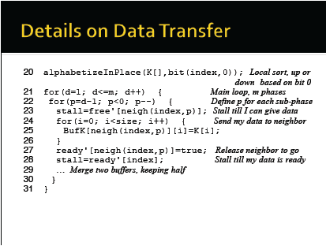

Slide 27


Slide 28
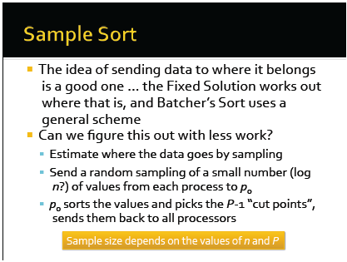

Slide 29
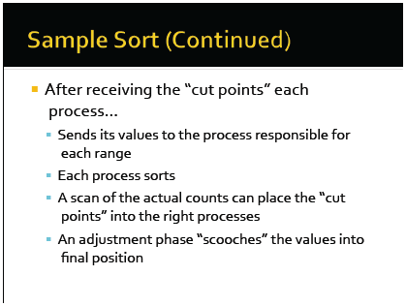

Slide 30
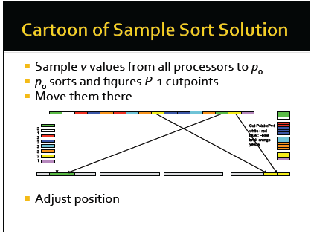

Slide 31
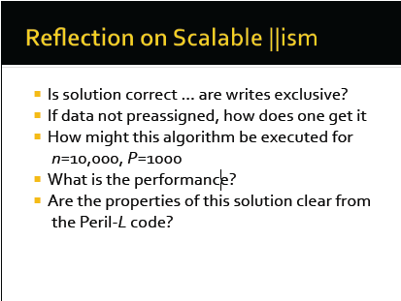

Slide 32
Comparing the Three Solutions
The odd/even sort is inefficient by any defn because it shifts the data towards its final destination at rate of one location move per time.
The alphabetic bins solution has a minimal amount of movement – a maximum of two transfers for any record.
While data movement is minimized, it uses excessive global communication to compute the positions of the letters.
The scalable solution requires significant movement of descriptors of data, but unlike fixed approach, it moves them in streams that can be pipelined.
The actual records are only moved once at the end of the process.

Slide 33
Comparing the Three Solutions (cont)
The main difference in the solutions is their generality regarding the number of processors they could use.
For n>P, the odd-even sort has to simulate threads.
The fixed solution can not use more than 26 threads.
The scalable method works for any number of threads up to P=n.

Slide 34


Slide 35
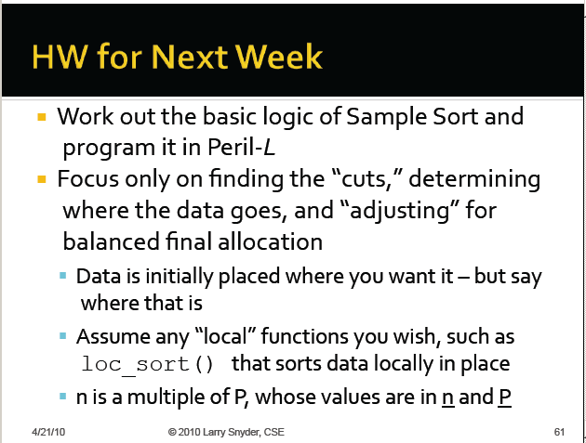
This HW is NOT Assigned

Slide 36
